Slide 1
Industrial Pharmacy II
By
Dr. Mohammed Sabbar
4th Oct. 2018
http://bit.do/ex2a6

Slide 2
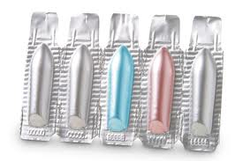
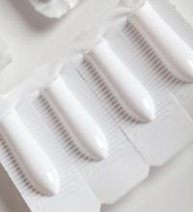
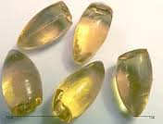
Suppository dosage form
1- Greater than 98% of all rectal dosage forms.
2-Torpedo-shaped dosage forms which vary in weight from 1g (children) to 2.5 g (adult).
3- Composed of fatty bases (low-melting) or water-soluble bases (dissolving),
Notes:
1- Solid suppositories are the most common dosage form used for rectal drug administration and represent greater than 98% of all rectal dosage forms.
2-these are torpedo-shaped dosage forms composed of fatty bases (low-melting) or water-soluble bases (dissolving), which vary in weight from 1g (children) to 2.5 g (adult).

Slide 3
Properties of an Ideal Base
1. Melt (fatty base) ) at temperatures just below body temperature or disintegrate, i.e. mix and dissolve, in the rectal fluids (water soluble base).
2. Release easily from the suppository mold
3. Correct viscosity
4. Be non-toxic and non-irritant to sensitive and inflamed tissue
5. Show chemical and physical stability
6. Be compatible with a range of drugs
Notes:
Properties of an Ideal Base
There are a number of inter-related biopharmaceutical and technological aspects to be considered when choosing the correct base for a specific drug.
An ideal base should-:
1. Melt (fatty base) or disintegrate, i.e. mix and dissolve, in the rectal fluids (water soluble base) at temperatures just below body temperature.
2. Release easily from the suppository mold
3. Be of the correct viscosity when molten to inhibit sedimentation but still allow the melt to flow into the mold and over the mucus membranes
4. Be non-toxic and non-irritant to sensitive and inflamed tissue
5. Show chemical and physical stability
6. Be compatible with a range of drugs

Slide 4
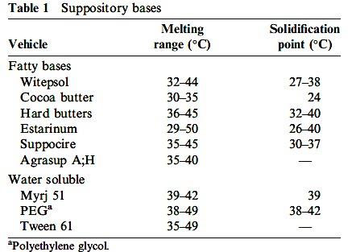

Slide 5
Specifications for Suppository Bases
Melting Range
Narrow enough to give rapid solidification during manufacture to prevent aggregation of suspended drug but slow enough to prevent faults and fissures forming.
Acid Value
No. of mgs of KOH required to neutralize the free fatty acids in 1gm of base.
Low acid values (below 3) are important for good suppository.
Water Number (Hydroxyl Value)
The water (g) that can be incorporated into 100g of base.
The water number can be increased by the addition surface active agents and other emulsifiers. This sometimes leads to the formation of a w/o emulsion in the rectum which should be avoided because it encourages slow release.
Iodine number
No. of g(s) of iodine that reacts with a 100 g of suppository base.
Values below 7 are usually specified.
Notes:
Specifications for Suppository Bases
Melting Range
Since fats do not have sharp melting points their melting characteristics are expressed as a range indicating the temperature at which the fat starts to melt and the temperature at which it is completely melted. This range should be narrow enough to give rapid solidification during manufacture to prevent aggregation of suspended drug but slow enough to prevent faults and fissures forming.
Acid Value
The acid value is the number of milligrams of potassium hydroxide required to neutralize the free fatty acids in 1gm of base. Low acid values (below 3) are important for good suppository bases as free acids may react with other ingredients and can also cause irritation when in contact with the mucus membranes.
Water Number (Hydroxyl Value)
The water number is the weight of water (g) that can be incorporated into 100g of base. This number is related to the amount of mono- and di-glycerides present in the base. High water numbers aid the incorporation of drugs, but are avoided with drugs that undergo decomposition by hydrolysis.
The water number can be increased by the addition surface active agents and other emulsifiers. This sometimes leads to the formation of a w/o emulsion in the rectum which should be avoided because it encourages slow release.
Iodine number
The iodine number expresses the weight (g) of iodine that reacts with a 100 g of suppository base. The value gives an indication of the amount of unsaturated material. High iodine values indicate that rancidity on storage might occur. Values below 7 are usually specified.

Slide 8
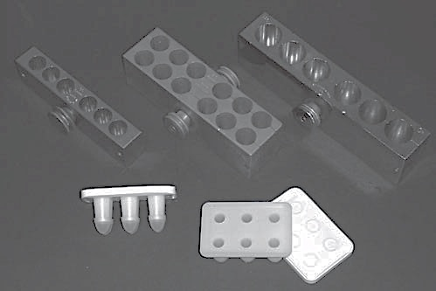
Manufacture of suppositories
1- Hand molding
2- Pour molding
3- Compression molding
4- Automatic molding machine

Slide 9
Specific problems in formulating supp.
Water in supp. Cause? 1,2,3, 4 and 5
Hygroscopicity in glycerinated gelatin supp.
Incompatibility
Viscosity
Brittleness
Density
Volume contraction
Lubricants and mold releasing agents
Dosage replacement factor
Weight and volume control
Rancidity and antioxidants
Notes:
Water accelerate oxidation of fats, on evaporation will crystalize drug, o/w emulsion not less than 50% to enhance the absorption, interaction between components of supp., and contamination

Slide 10
Testing of supp.
Melting range test using tablet disintegration tester
Softening time(liquefaction)
Breaking test (hardness)
Dissolution test (tablet dissolution and flow through cell)
Storage of supp.

